Slide 1
CSCNSI 2015
Course Introduction

Slide 2
Introduction
Course Goals
Course Layout
Expectations
About Me
About You

Slide 3
Course Goals

Slide 4
Course Goals
Cluster Assembly and Management (Boot Camp)
Hardware assembly
Software selection/installation/configuration
Cluster provisioning
Network management
Performance monitoring
And more

Slide 5
Course Goals (continued)
Research Project
Specialized Skill Development
Poster and Talks
Attend talks for breadth of knowledge
Start thinking about the future of HPC

Slide 6
Reasons for This Institute
To train potential workforce
Practical skills
Great recruiting mechanism
Technical skills
Work ethic
Professionalism and teamwork
Communication skills

Slide 7
Other Course Goals
Enjoy yourselves; have fun!
Meet new people
Play with a bunch of cool stuff
Get to know the area

Slide 8
Course Layout

Slide 9
Course Layout
Boot Camp
Research Projects
Poster and Presentation Session

Slide 10
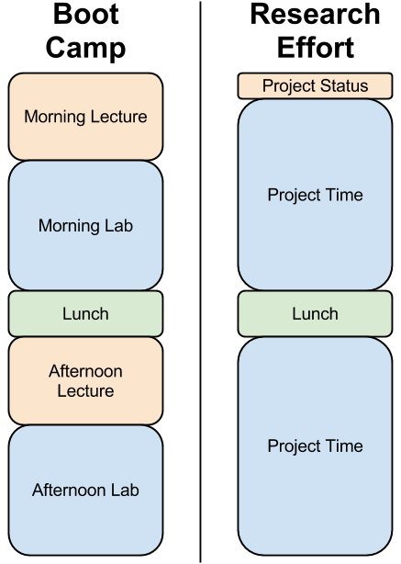
Daily Layout
Lectures
Labs
Other talks and activities
Lunch
Fridays w/ Gary Grider

Slide 11
Learn as You Go
Lectures are a general overview
Students are expected to learn details on your own
Simulates real-life work situations

Slide 12
Expectations

Slide 13
Safety Expectations
Closed-toed shoes
Pants (when working with equipment)
No heavy lifting
Servers always require two-person lift
Stay away from stuff that appears dangerous
Stop any activity that appears dangerous
If you have any questions regarding safety, ASK!

Slide 14
Expectations
Professionalism with
Each other
NMC/PRObE/LANL teams
The Instructor
High work ethic
Show up on time and work the whole day
Pull your own weight on your team

Slide 15
Evaluations
You will be evaluated
By the instructor
By your mentors
By your teammates
Don’t be a jerk

Slide 16
It’s a Two Way Street
We want to make this a great experience for you
Let us know what we can change for the better
Please remember, the instructor and your mentors:
Are human beings
Are not infallible
Do not know everything

Slide 17

One Last Thing
Failure is an option
I will fail students who make no effort
But for projects:
Sometimes failure is the right answer
A new technology may not be ready for production

Slide 18
About Me

Slide 19
About Me
Went to school for BS in Computer Science
Graduated from NMT in Dec 2014
Attended this institute in 2012
TA for this institute in 2013
LANL’s HPC-3 File Systems Team
First year teaching the institute

Slide 20
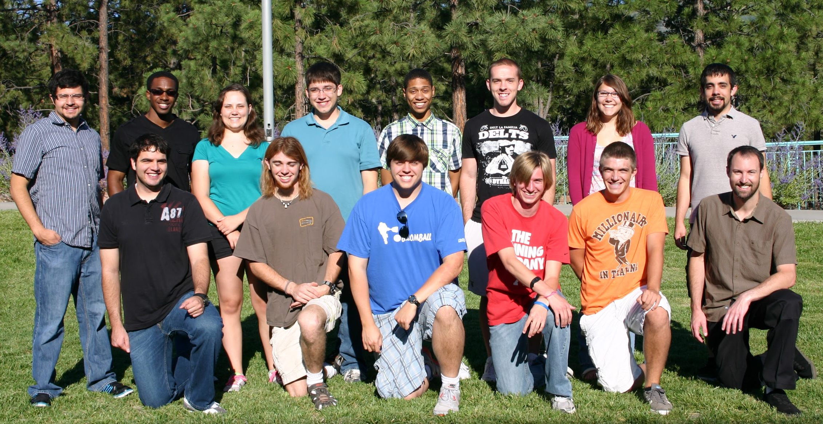
About Me 2012

Slide 21
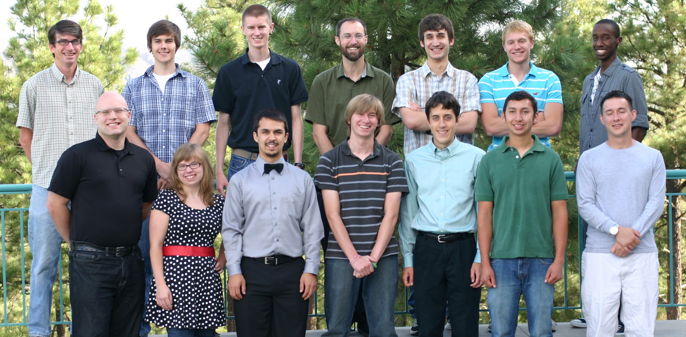
About Me 2013

Slide 22
About You

Slide 23
About You
Briefly introduce yourself

Slide 24
Summary
Course Goals
Course Layout
Expectations
About Me
About You

